Slide 1
Revised Data Analysis Texas Precipitation Gradient (2017)
For PeerJ revision
By Sean Kinard

Slide 2
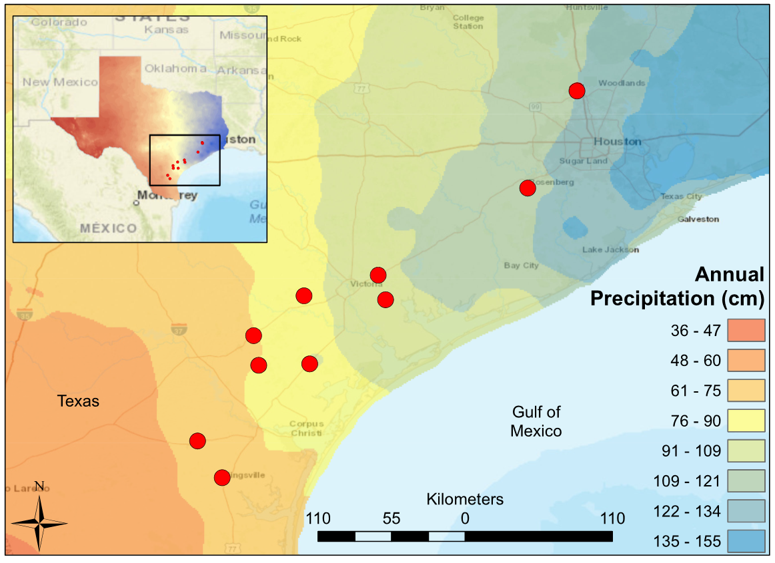
Environmental Feature | Mean | Interquartile Range
Precipitaiton (cm/yr) | 92.5 | 24.6
Mean Air Temperature (°C) | 21.1 | 0.3
Minimum Air Temperature (°C) | 15.1 | 0.4
Maximum Air Temperature (°C) | 27.5 | 0.8
Elevation (m) | 29.9 | 32.0
Average Basin Slope (%) | 0.7 | 0.8
Human Development (%) | 13.3 | 5.8
Planted Cropland (%) | 41.8 | 23.9
Average Clay Content (%) | 30.5 | 4.6
Average Silt Content (%) | 31.0 | 2.1
Average Sand Content (%) | 38.5 | 3.9
Table 1: Mean and interquartile range values for environmental gradient features of 10 samples sites spanning the Texas Coastal Prairie. The source data was collected from from US Geologic Surveyors Geospatial Attributes of Gages for Evaluating Streamflow, version II dataset (Falcone 2011).
Figure 1: Map of South-Central Texas, where 10 USGS gaged Streams were sampled in the Spring of 2017. An annual precipitation overlay indicate that the sample sites span a gradient from 61 cm/yr in the Southwest to 134 cm/yr in the Northeast.
Notes:
Table 1: Mean and interquartile range values for environmental gradient features of 10 samples sites spanning the Texas Coastal Prairie. The source data was collected from from US Geologic Surveyors Geospatial Attributes of Gages for Evaluating Streamflow, version II dataset (Falcone 2011).
Figure 1: Map of South-Central Texas, where 10 USGS gaged Streams were sampled in the Spring of 2017. An annual precipitation overlay indicate that the sample sites span a gradient from 61 cm/yr in the Southwest to 134 cm/yr in the Northeast.

Slide 3

Site Name | USGS Station ID | Precipitation (cm/yr) | Flash Index | Low Flow Pulse % | Rosgen Index | Canopy (%) | NH₄⁺ (mg/L) | Conductivity ln(µS/cm)
Aransas | 8189700 | 80.770 | 1.053 | 7.664 | 11.781 | 58.559 | 0.105 | 6.835
Bear Branch | 8068390 | 124.190 | 0.777 | 13.146 | 12.011 | 44.144 | 0.133 | 5.426
Big Creek | 8115000 | 120.310 | 0.961 | 15.631 | 23.150 | 0.000 | 0.118 | 5.390
Garcitas | 8164600 | 102.410 | 0.806 | 4.867 | 18.161 | 73.649 | 0.098 | 6.249
Medio | 8189300 | 79.130 | 0.993 | 0.000 | 18.405 | 14.414 | 0.113 | 6.748
Mission | 8189500 | 85.360 | 0.580 | 3.357 | 14.701 | 68.468 | 0.170 | 7.163
Perdido | 8177300 | 92.370 | 1.339 | 0.000 | 15.152 | 0.901 | 0.075 | 6.602
Placedo | 8164800 | 104.650 | 0.921 | 5.482 | 13.380 | 29.279 | 0.088 | 7.035
San Fernando | 8211900 | 67.750 | 0.907 | 20.306 | 15.762 | 89.865 | 0.298 | 6.887
Tranquitas | 8212300 | 67.750 | 0.781 | 24.060 | 17.988 | 68.769 | 0.153 | 9.096
Table 2: Environmental Predictors for the 10 sample sites. Annual precipitation, Flash Index, and Low Flow Pulse % are calculated using 30-year records provided by USGS stream gauges. Rosgen Index (stream width / stream depth), Canopy %, NH4+, and Conductivity were measured in-situ in during Spring 2017 sampling.
Notes:
Table 2: Environmental Predictors for the 10 sample sites. Annual precipitation, Flash Index, and Low Flow Pulse % are calculated using 30-year records provided by USGS stream gauges. Rosgen Index (stream width / stream depth), Canopy %, NH4+, and Conductivity were measured in-situ in during Spring 2017 sampling.

Slide 4
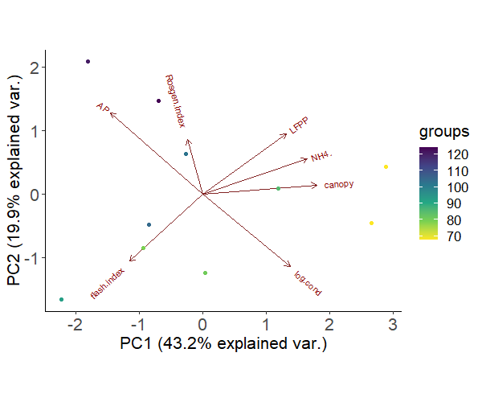
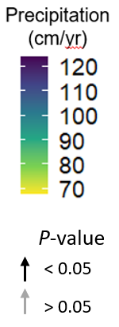
Precipitation
Low Flow
Pulse %
Rosgen Index
Precipitation
(cm/yr)
Variation | PC1 | PC2
Proportion of Variance | 0.432 | 0.199
Cumulative Proportion | 0.432 | 0.631
Standard deviation | 1.739 | 1.179
Correlation (R) | PC1 | PC2
Precipitation | -0.698 | 0.615
Conductivity | 0.663 | -0.550
Rosgen Index | -0.111 | 0.411
Canopy | 0.867 | 0.069
NH₄⁺ | 0.792 | 0.265
Flash Index | -0.553 | -0.508
Low Flow Pulse % | 0.633 | 0.456
NH₄⁺
PC1 (19.9%)
Canopy
Flash Index
Conductivity
PC1 (43.2%)
Table 3: Above: Proportion of total variation captured in principle component axes 1 or 2 of environmental predictors at 10 sites spanning a precipitation gradient along the Texas Coastal Prairie. Below: Correlation coefficients for environmental predictors versus principal component axes 1 or 2.
Figure 2: Principal Component Analysis of environmental predictors at 10 sites spanning a precipitation gradient along the Texas Coastal Prairie. Circles representing sample sites are colored based on their annual precipitation. Axes labels include the percentage of variance explained by PC1 (horizontal axis) and PC2 (vertical axis).
Notes:
Figure 2: Principal Component Analysis of environmental predictors at 10 sites spanning a precipitation gradient along the Texas Coastal Prairie. Circles representing sample sites are colored based on their annual precipitation. Axes labels include the percentage of variance explained by PC1 (horizontal axis) and PC2 (vertical axis).
Table 3: Above: Proportion of total variation captured in principle component axes 1 or 2 of environmental predictors at 10 sites spanning a precipitation gradient along the Texas Coastal Prairie. Below: Correlation coefficients for environmental predictors versus principal component axes 1 or 2.

Slide 5
Response | Input | Sign | Slope | R² | F-stat | df | p-value
Conductivity | Canopy | + | 0.410 | 0.168 | 1.617 | 2 | 0.239
Flash Index | Canopy | - | 0.612 | 0.375 | 4.796 | 2 | 0.06
Low Flow Pulse % | Canopy | + | 0.420 | 0.176 | 1.712 | 2 | 0.227
NH₄⁺ | Canopy | + | 0.643 | 0.414 | 5.649 | 2 | 0.045 *
Rosgen Index | Conductivity | - | 0.074 | 0.006 | 0.044 | 2 | 0.838
Conductivity | Flash Index | - | 0.174 | 0.030 | 0.251 | 2 | 0.63
Low Flow Pulse % | Flash Index | - | 0.309 | 0.096 | 0.847 | 2 | 0.384
NH4 | Flash Index | - | 0.373 | 0.139 | 1.291 | 2 | 0.289
Rosgen Index | Flash Index | + | 0.007 | 0.000 | 0.000 | 2 | 0.984
Conductivity | Low Flow Pulse % | + | 0.285 | 0.081 | 0.706 | 2 | 0.425
NH₄⁺ | Low Flow Pulse % | + | 0.595 | 0.354 | 4.383 | 2 | 0.07
Rosgen Index | Low Flow Pulse % | + | 0.217 | 0.047 | 0.395 | 2 | 0.547
Conductivity | NH₄⁺ | + | 0.194 | 0.038 | 0.315 | 2 | 0.59
Rosgen Index | NH₄⁺ | + | 0.003 | 0.000 | 0.000 | 2 | 0.994
Canopy | Precipitation | - | 0.483 | 0.233 | 2.429 | 2 | 0.158
Conductivity | Precipitation | - | 0.785 | 0.616 | 12.817 | 2 | 0.007 *
Flash Index | Precipitation | - | 0.025 | 0.001 | 0.005 | 2 | 0.945
Low Flow Pulse % | Precipitation | - | 0.160 | 0.026 | 0.210 | 2 | 0.659
NH4 | Precipitation | - | 0.480 | 0.230 | 2.395 | 2 | 0.16
Rosgen Index | Precipitation | + | 0.073 | 0.005 | 0.042 | 2 | 0.842
Canopy | Rosgen.Index | - | 0.301 | 0.091 | 0.798 | 2 | 0.398
Table 4: Summary statistics for linear autocorrelations among environmental predictors. * denotes a statistically significant correlation (p-value < 0.05).
Notes:
Table 4: Summary statistics for linear autocorrelations among environmental predictors. * denotes a statistically significant correlation (p-value < 0.05).

Slide 6
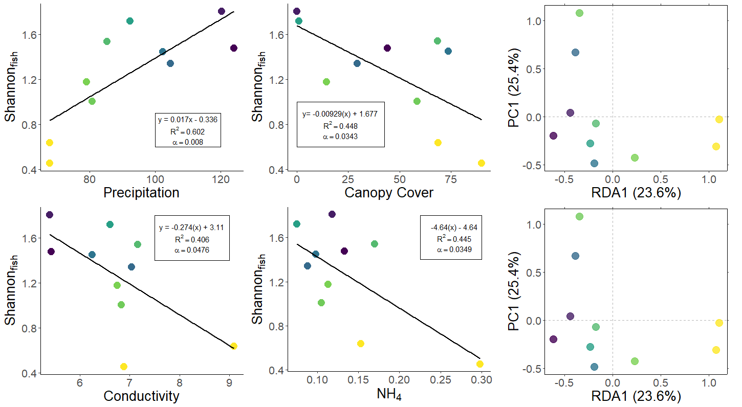
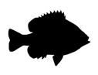
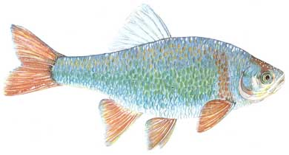
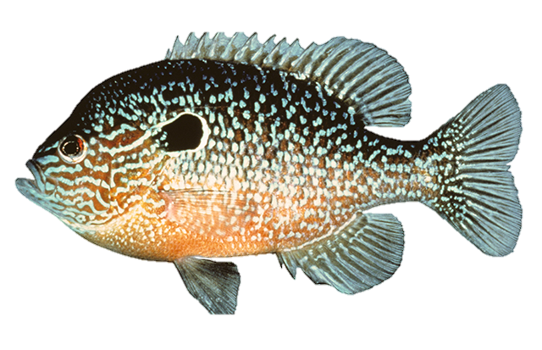
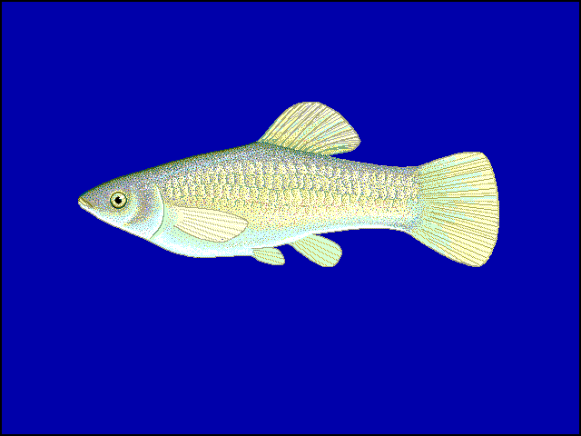
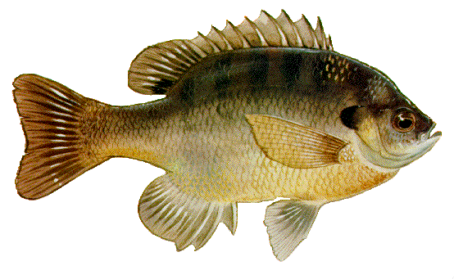
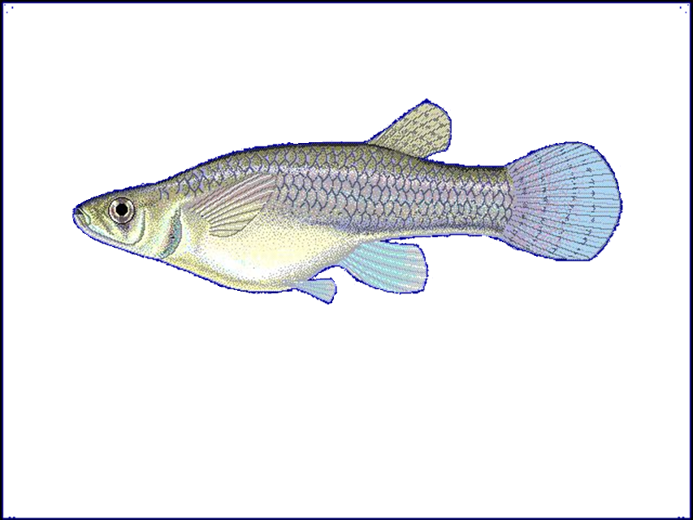
a
c
e
Flash Index
Conductivity
Canopy
Low Flow Pulse %
NH₄⁺
Precipitation
Rosgen Index
b
d
f
C. lutrensis
L. megalotis
P. latipinna
L. macrochirus
G. affinis
NH₄⁺
Figure 4: Fish diversity plotted against (a) annual precipitation (cm/yr), (b) log-transformed conductivity (µS/cm), (c) canopy cover (%), (d) NH₄⁺ (mg/L). (E & F) Fish community ordinations using Hellinger transformation and redundancy analysis. Axes labels display the proportion of the variance explained as a percentage. Colored circles represent sites with color determined by annual precipitation. Arrows depict fitted vectors for (e) species and (f) environmental predictors which can be visually interpreted based on their direction. Black arrows indicate statistically significant (p-value < 0.05) correlations. Only significant species vectors were plotted to improve figure clarity.
Notes:
Figure 3: Fish diversity plotted against (a) annual precipitation (cm/yr), (b) log-transformed conductivity (µS/cm), (c) canopy cover (%), (d) NH₄⁺ (mg/L). (E & F) Fish community ordinations using Hellinger transformation and redundancy analysis. Axes labels display the proportion of the variance explained as a percentage. Colored circles represent sites with color determined by annual precipitation. Arrows depict fitted vectors for (e) species and (f) environmental predictors which can be visually interpreted based on their direction. Black arrows indicate statistically significant (p-value < 0.05) correlations. Only significant species vectors were plotted to improve figure clarity.

Slide 7
Response | Input | Sign | Slope | R² | F-stat | df | p-value
Shannon_{Fish} | Canopy | - | 0.009 | 0.448 | 6.490 | 1 | 0.034 *
Shannon_{Fish} | Conductivity | - | 0.274 | 0.406 | 5.464 | 1 | 0.048 *
Shannon_{Fish} | Flash Index | + | 0.339 | 0.024 | 0.193 | 1 | 0.672
Shannon_{Fish} | Low Flow Pulse % | - | 0.031 | 0.339 | 4.102 | 1 | 0.077
Shannon_{Fish} | NH₄⁺ | - | 4.647 | 0.446 | 6.431 | 1 | 0.035 *
Shannon_{Fish} | Precipitation | + | 0.017 | 0.602 | 12.101 | 1 | 0.008 *
Shannon_{Fish} | Rosgen Index | + | 0.021 | 0.027 | 0.224 | 1 | 0.649
Table 5: Summary statistics for linear regressions of fish Shannon Index values versus environmental predictors. * denotes a statistically significant correlation (p-value < 0.05).
Notes:
Table 5: Summary statistics for linear regressions of fish Shannon Index values versus environmental predictors. * denotes a statistically significant correlation (p-value < 0.05).

Slide 8
Candidate Model Formula | df | Log-Likelihood | AIC_{c} | Δ AIC_{c} | Weight
+ 0.313*Precipitation - 0.210*Low Flow Pulse % | 4 | 2.912 | 10.2 | 0 | 0.429
+ 0.346*Precipitation | 3 | -0.985 | 12 | 1.79 | 0.175
+ 0.263*Precipitation - 0.172*Canopy | 4 | 0.69 | 14.6 | 4.44 | 0.046
+ 0.264*Precipitation -0.171*NH4+ | 4 | 0.688 | 14.6 | 4.45 | 0.046
-0.235*Conductivity - 0.252*NH4+ | 4 | 0.649 | 14.7 | 4.52 | 0.045
-0.299*Canopy | 3 | -2.622 | 15.2 | 5.07 | 0.034
-0.298*NH4+ | 3 | -2.642 | 15.3 | 5.11 | 0.033
- 0.284*Conductivity | 3 | -2.989 | 16 | 5.8 | 0.024
+ 0.301*Precipitation - 0.234*Low Flow Pulse % + 0.103*Rosgen Index | 5 | 4.501 | 16 | 5.82 | 0.023
random effects | 2 | -5.592 | 16.9 | 6.72 | 0.015
- 0.26*Low Flow Pulse % | 3 | -3.523 | 17 | 6.87 | 0.014
+ 0.348*Precipitation + 0.077*Flash Index | 4 | -0.594 | 17.2 | 7.01 | 0.013
+ 0.273*Precipitation - 0.092*Canopy - 0.177*Low Flow Pulse % | 5 | 3.732 | 17.5 | 7.36 | 0.011
+ 0.343*Precipitation + 0.049*Rosgen Index | 4 | -0.834 | 17.7 | 7.49 | 0.010
- 0.219*Canopy - 0.195*Conductivity | 4 | -0.936 | 17.9 | 7.7 | 0.009
+ 0.321*Precipitation - 0.033*Conductivity | 4 | -0.959 | 17.9 | 7.74 | 0.009
- 0.195*Low Flow Pulse % - 0.229*Conductivity | 4 | -1.248 | 18.5 | 8.32 | 0.007
+ 0.357*Precipitation - 0.219*Low Flow Pulse % + 0.058*Conductivity | 5 | 3.082 | 18.8 | 8.66 | 0.006
+ 0.294*Precipitation - 0.185*Low Flow Pulse % - 0.047*NH4+ | 5 | 3.061 | 18.9 | 8.7 | 0.006
- 0.230*Canopy - 0.163*Low Flow Pulse % | 4 | -1.51 | 19 | 8.84 | 0.005
+ 0.314*Precipitation + 0.013*Flash Index - 0.206*Low Flow Pulse % | 5 | 2.932 | 19.1 | 8.96 | 0.005
- 0.411*Canopy - 0.183*Flash Index | 4 | -1.568 | 19.1 | 8.96 | 0.005
- 0.183*Canopy - 0.180*NH4+ | 4 | -1.669 | 19.3 | 9.16 | 0.004
Table 6. Predictor variables and coefficients (formula), degrees of freedom (df) , log-likelihood, Akaike’s Information Criterion with the small-sample bias adjustment (AIC_{c} ), difference from the best-ranked model’s AIC_{c} (Δ AIC_{c} ), and Akaike weights (w) for set of nonlinear, multivariate regressions predicting fish Shannon diversity.
Notes:
Table 6. Predictor variables and coefficients (formula), degrees of freedom (df) , log-likelihood, Akaike’s Information Criterion with the small-sample bias adjustment (AIC_{c} ), difference from the best-ranked model’s AIC_{c} (Δ AIC_{c} ), and Akaike weights (w) for set of nonlinear, multivariate regressions predicting fish Shannon diversity.

Slide 9
Fitted Vector |  | axis1 | axis2 | R | p-value
Environment
 | Canopy | 0.924 | 0.383 | 0.292 | 0.302
 | Conductivity | 0.938 | 0.345 | 0.539 | 0.051
 | Flash Index | -0.434 | 0.901 | 0.033 | 0.877
 | Low Flow Pulse % | 0.949 | 0.315 | 0.357 | 0.214
 | NH₄⁺ | 0.986 | 0.167 | 0.494 | 0.104
 | Precipitation | -0.941 | -0.340 | 0.726 | 0.013 *
 | Rosgen Index | 0.149 | -0.989 | 0.241 | 0.363
Species
 | C.lutrensis | -0.217 | 0.627 | 0.880 | 0.007 *
 | L.megalotis | -0.407 | -0.021 | 0.720 | 0.013 *
 | P.latipinna | 0.415 | -0.090 | 0.837 | 0.016 *
 | L.macrochirus | -0.240 | -0.061 | 0.756 | 0.018 *
 | G.affinis | 0.188 | -0.340 | 0.618 | 0.041 *
Table 7: Radial coordinates and summary statistics for fitted vectors of species and environmental predictors within the fish RDA ordination. * denotes a statistically significant correlation (p-value < 0.05).
Notes:
Table 7: Radial coordinates and summary statistics for fitted vectors of species and environmental predictors within the fish RDA ordination. * denotes a statistically significant correlation (p-value < 0.05).

Slide 10
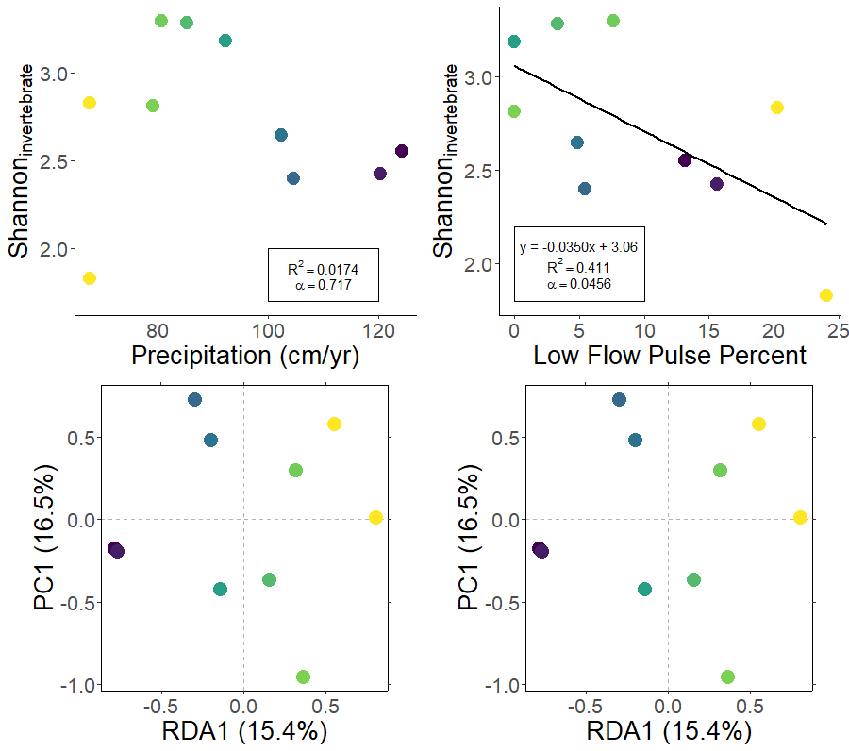
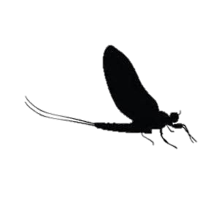
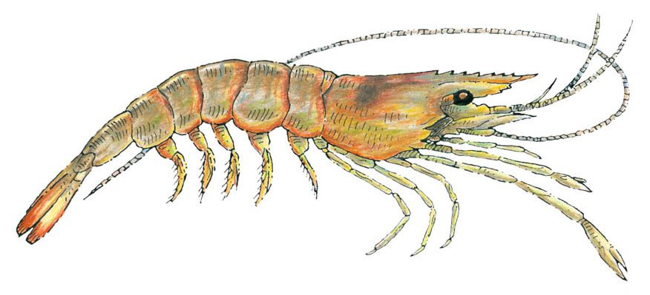
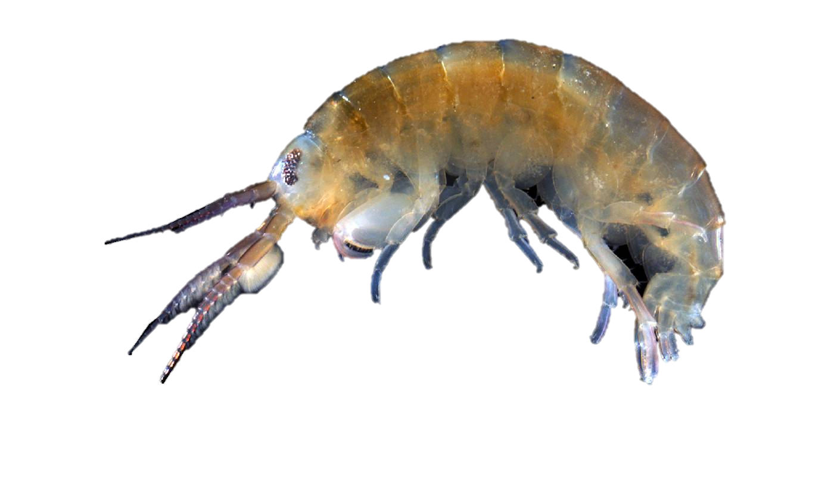
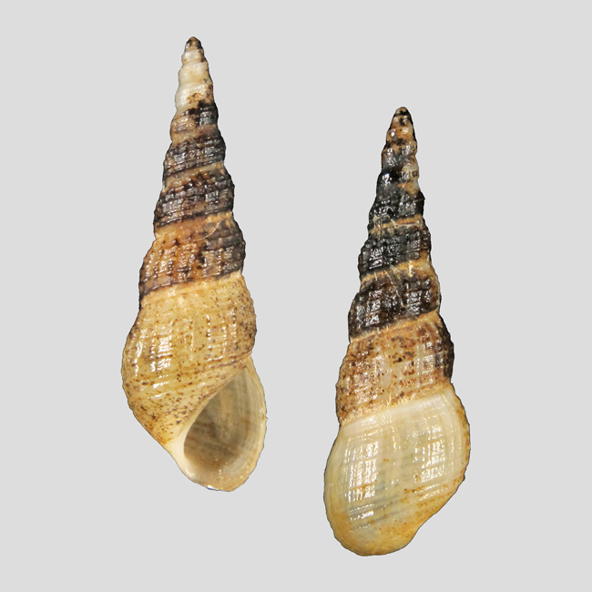
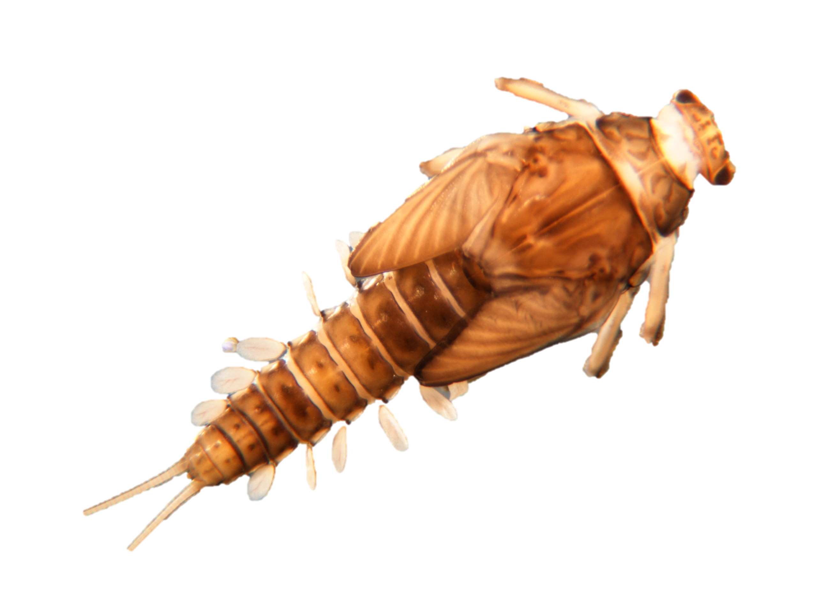
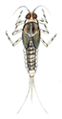
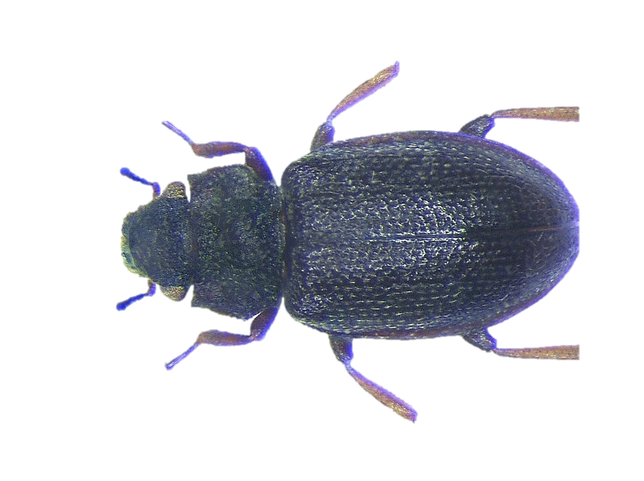
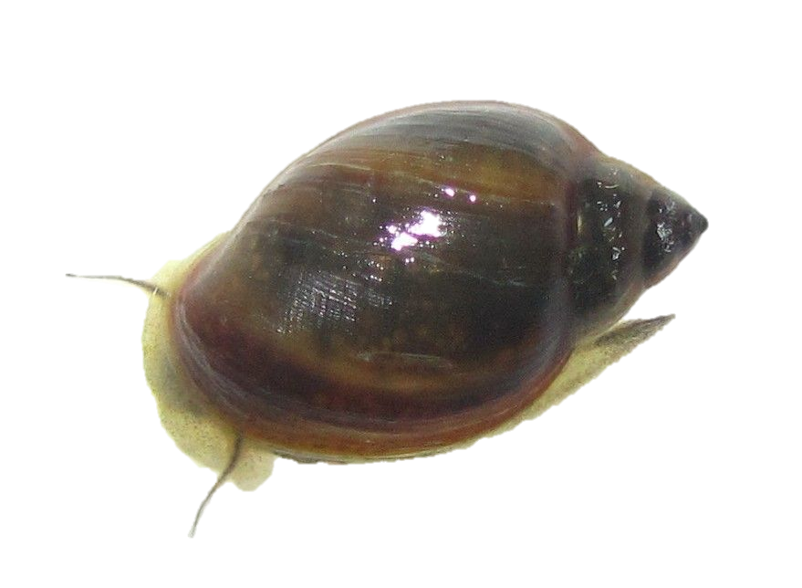
a
b
Figure 5: Macroinvertebrate Shannon diversity plotted against (A) annual precipitation (cm/yr) and (B) Low Flow Pulse Percent. (C & D) Fish community ordinations using Hellinger transformation and redundancy analysis. Axes labels contain proportion of the variance explained as a percentage. Dots represent sites with color determined by annual precipitation. Arrows represent fitted vectors for (C) environmental predictors and (D) species which can be visually interpreted based on their direction. Black arrows indicate statistically significant (p-value < 0.05) correlations. Only significant species vectors were plotted to improve figure clarity.
c
Low Flow Pulse %
d
Cheumatopsyche
Canopy
NH₄⁺
Palaemonetes
Precipitation
Conductivity
Hyalella
Melanoides
Plauditus
Hydraena
Caenis
Physa
Flash Index
Rosgen Index
Notes:
Figure 4: Macroinvertebrate Shannon diversity plotted against (A) annual precipitation (cm/yr) and (B) Low Flow Pulse Percent. (C & D) Fish community ordinations using Hellinger transformation and redundancy analysis. Axes labels contain proportion of the variance explained as a percentage. Dots represent sites with color determined by annual precipitation. Arrows represent fitted vectors for (C) environmental predictors and (D) species which can be visually interpreted based on their direction. Black arrows indicate statistically significant (p-value < 0.05) correlations. Only significant species vectors were plotted to improve figure clarity.

Slide 11
Response | Input | Sign | estimate | df | R² | F-stat | p-value
Shannon_{Invert} | Precipitation | - | 0.003 | 2 | 0.017 | 0.141 | 0.717
Shannon_{Invert} | Conductivity | - | 0.134 | 2 | 0.091 | 0.802 | 0.397
Shannon_{Invert} | Rosgen Index | - | 0.054 | 2 | 0.168 | 1.612 | 0.240
Shannon_{Invert} | Canopy | - | 0.000 | 2 | 0.000 | 0.002 | 0.966
Shannon_{Invert} | NH₄⁺ | - | 0.065 | 2 | 0.000 | 0.001 | 0.980
Shannon_{Invert} | Flash Index | + | 0.623 | 2 | 0.075 | 0.650 | 0.443
Shannon_{Invert} | Low Flow Pulse % | - | 0.035 | 2 | 0.411 | 5.591 | 0.046 *
Table 8: Summary statistics for linear regressions of inverebrate Shannon Index values versus environmental predictors. * denotes a statistically significant correlation (p-value < 0.05).
Notes:
Table 8: Summary statistics for linear regressions of inverebrate Shannon Index values versus environmental predictors. * denotes a statistically significant correlation (p-value < 0.05).

Slide 12
Candidate Model Formula | df | Log-Likelihood | AIC_{c} | Δ AIC_{c} | Weight
-0.035*Low Flow Pulse % | 3 | -3.236 | 16.5 | 0 | 0.299
Random Effects | 2 | -5.886 | 17.5 | 1.01 | 0.18
-0.054*Low Flow Pulse % + 4.133*NH₄⁺ | 4 | -0.967 | 17.9 | 1.46 | 0.144
-0.054*Rosgen Index | 3 | -4.968 | 19.9 | 3.46 | 0.053
-0.134*Conductivity | 3 | -5.409 | 20.8 | 4.34 | 0.034
+ 0.623*Flash Index | 3 | -5.495 | 21 | 4.52 | 0.031
+ 0.004*Canopy -0.04203*Low Flow Pulse % | 4 | -2.524 | 21 | 4.58 | 0.03
-0.032*Low Flow Pulse % -0.038*Rosgen Index | 4 | -2.538 | 21.1 | 4.6 | 0.03
-0.005*Precipitation -0.037*Low Flow Pulse % | 4 | -2.733 | 21.5 | 4.99 | 0.025
-0.003*Precipitation | 3 | -5.799 | 21.6 | 5.12 | 0.023
-0.000*Canopy | 3 | -5.885 | 21.8 | 5.3 | 0.021
-0.065*NH₄⁺ | 3 | -5.886 | 21.8 | 5.3 | 0.021
-0.022*Precipitation -0.468*Conductivity | 4 | -2.945 | 21.9 | 5.42 | 0.02
-0.033*Low Flow Pulse % -0.058*Conductivity | 4 | -3.103 | 22.2 | 5.73 | 0.017
+ 0.190*Flash Index -0.034*Low Flow Pulse % | 4 | -3.182 | 22.4 | 5.89 | 0.016
-0.020*Precipitation -0.030*Low Flow Pulse % -0.368*Conductivity | 5 | 0.367 | 24.3 | 7.79 | 0.006
-0.148*Conductivity -0.0575*Rosgen Index | 4 | -4.252 | 24.5 | 8.03 | 0.005
+ 0.630*Flash Index -0.054*Rosgen Index | 4 | -4.484 | 25 | 8.5 | 0.004
-0.002*Canopy -0.060*Rosgen Index | 4 | -4.839 | 25.7 | 9.21 | 0.003
-0.050*Low Flow Pulse % + 3.835*NH₄⁺ -0.028*Rosgen Index | 5 | -0.37 | 25.7 | 9.27 | 0.003
+ 0.494*Flash Index -0.052*Low Flow Pulse % + 4.588*NH₄⁺ | 5 | -0.399 | 25.8 | 9.33 | 0.003
-0.002*Precipitation -0.053*Rosgen Index | 4 | -4.905 | 25.8 | 9.34 | 0.003
-0.057*NH₄⁺ -0.054*Rosgen Index | 4 | -4.968 | 25.9 | 9.46 | 0.003
+ 0.520*Flash Index -0.116*Conductivity | 4 | -5.122 | 26.2 | 9.77 | 0.002
-0.052*Low Flow Pulse % -0.065*Conductivity + 4.174*NH₄⁺ | 5 | -0.7 | 26.4 | 9.93 | 0.002
Table 9. Predictor variables and coefficients (formula), degrees of freedom (df) , log-likelihood, Akaike’s Information Criterion with the small-sample bias adjustment (AIC_{c} ), difference from the best-ranked model’s AIC_{c} (Δ AIC_{c} ), and Akaike weights (w) for set of nonlinear, multivariate regressions predicting invertebrate Shannon diversity.
Notes:
Table 9. Predictor variables and coefficients (formula), degrees of freedom (df) , log-likelihood, Akaike’s Information Criterion with the small-sample bias adjustment (AIC_{c} ), difference from the best-ranked model’s AIC_{c} (Δ AIC_{c} ), and Akaike weights (w) for set of nonlinear, multivariate regressions predicting invertebrate Shannon diversity.

Slide 13
Vector Input |  | axis1 | axis2 | R | p-value
Environment
 | Precipitation | 0.976 | 0.001 | -1.000 | 0.022 *
 | Conductivity | 0.711 | 0.008 | 0.995 | 0.103
 | Rosgen Index | 0.074 | 0.759 | -0.222 | -0.975 *
 | Canopy | 0.550 | 0.082 | 0.697 | 0.717
 | NH₄⁺ | 0.250 | 0.372 | 0.888 | 0.460
 | Flash Index | 0.022 | 0.935 | -0.389 | -0.921 *
 | Low Flow Pulse % | 0.171 | 0.502 | 0.494 | 0.869
Genus
 | Hyalella | -0.168 | 0.005 | 0.780 | 0.007 *
 | Cheumatopsyche | -0.140 | 0.158 | 0.741 | 0.009 *
 | Melanoides | 0.266 | -0.002 | 0.691 | 0.017 *
 | Plauditus | -0.138 | -0.091 | 0.661 | 0.027 *
 | Physa | 0.047 | -0.158 | 0.639 | 0.033 *
 | Caenis | -0.135 | -0.162 | 0.642 | 0.037 *
 | Palaemonetes | -0.135 | 0.024 | 0.575 | 0.045 *
Table 10. Radial coordinates and summary statistics for fitted vectors of species and environmental predictors within the invertebrate RDA ordination. * denotes a statistically significant correlation (p-value < 0.05).
Notes:
Table 10. Radial coordinates and summary statistics for fitted vectors of species and environmental predictors within the invertebrate RDA ordination. * denotes a statistically significant correlation (p-value < 0.05).

